Slide 1
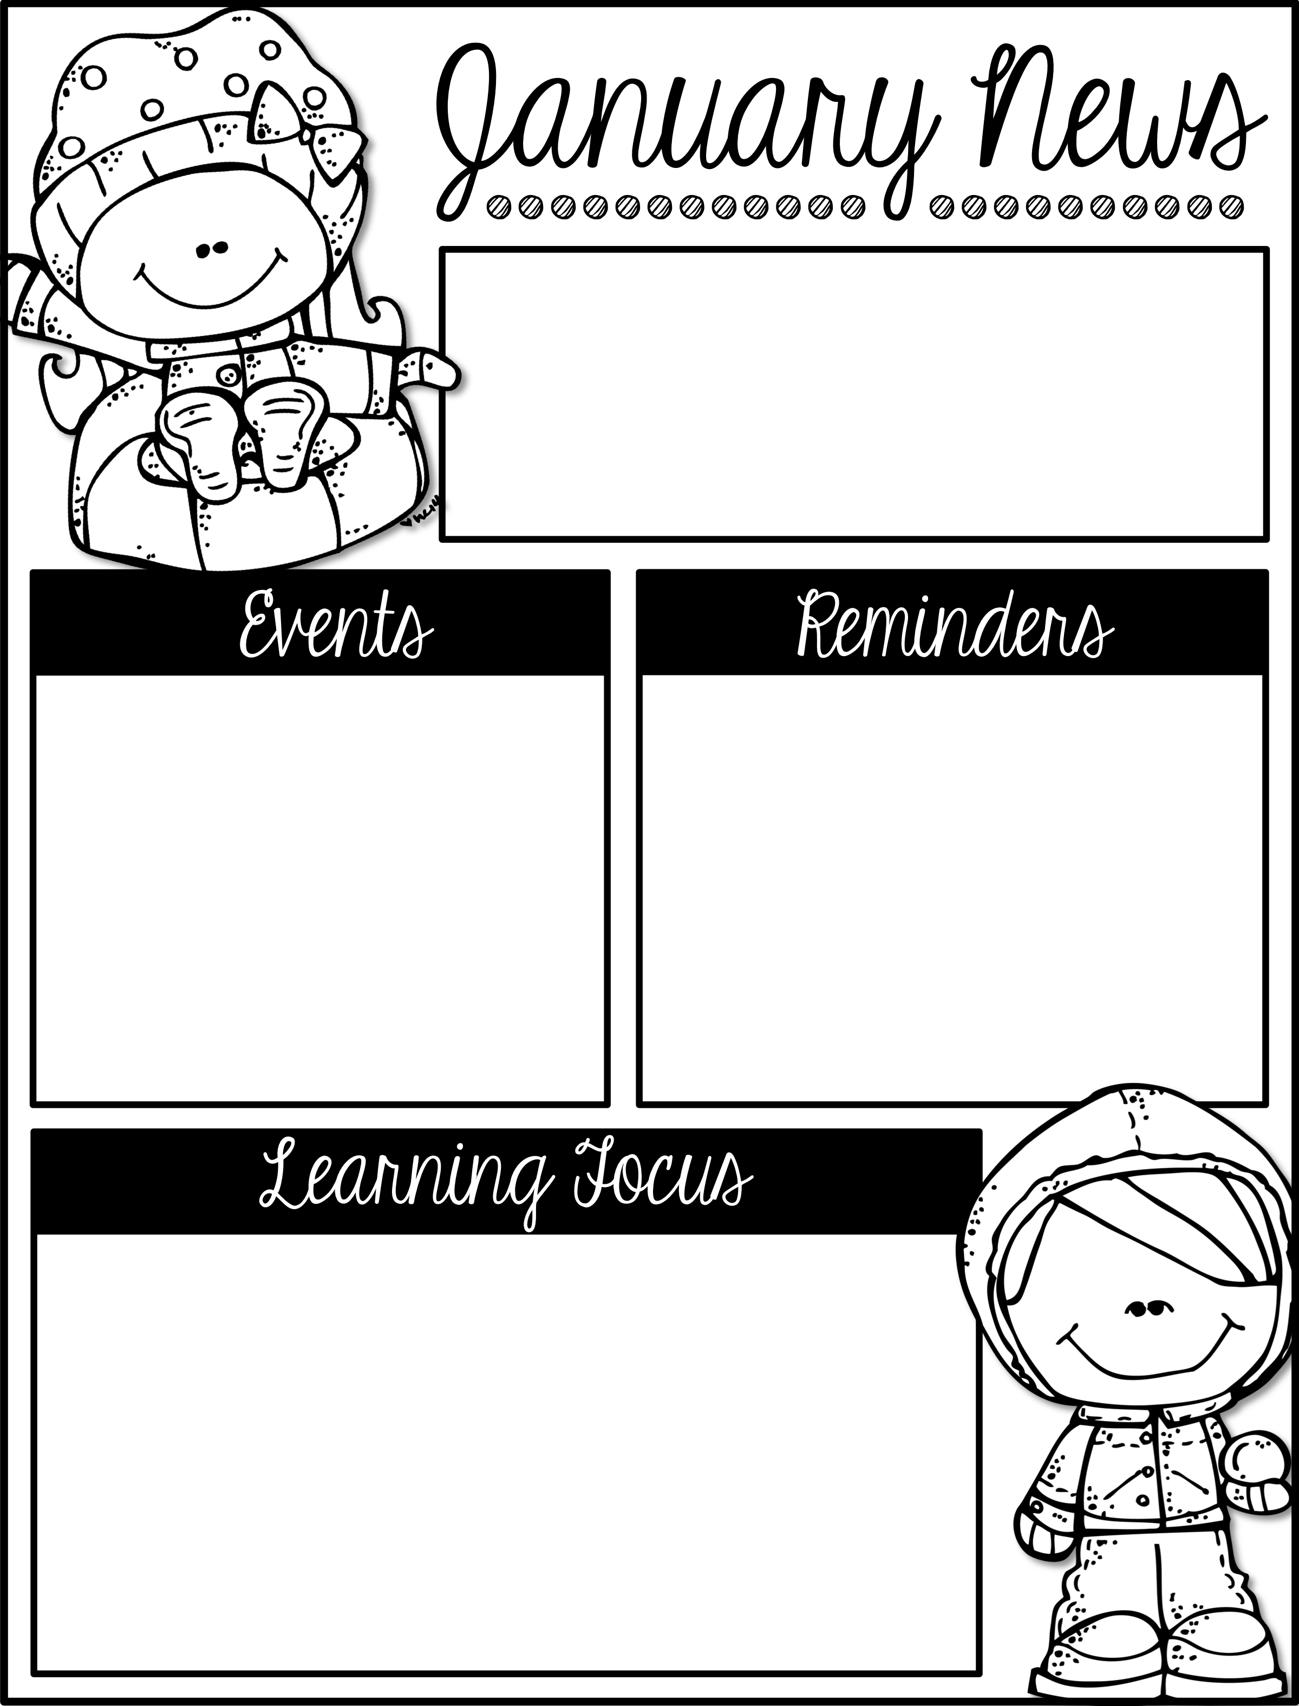
Mrs. Schwabauer’s
First Grade
Week of January 7-11, 2019
January 21: No School for MLK holiday
February 1: January Reading Celebration
GO CHIEFS!!!
*A big thank you for all of the love for Christmas! I am humbled by your generosity. I hope you all had a wonderful break! Cheers to 2019!
*There is a January Reading Challenge. It is due on Thursday, January 31.
*I can read and write words with Long i.
*I can sequence story events.
*I can write a thank you letter.
*I can create a story with a problem and a solution.
*I can set goals.
*I can add three numbers.
*I can solve story problems with three addends.
*I can explain how to make a ten when adding with 9.
*I can add explain how to make a ten when adding with 8.

