Slide 1
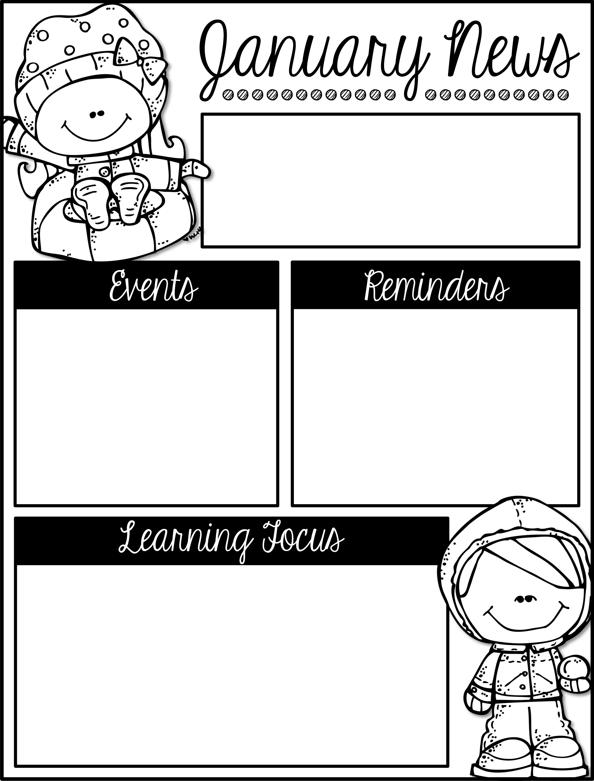
Mrs. Schwabauer’s
First Grade
Week of January 14-18, 2019
January 21: No School for MLK holiday
February 1: January Reading Celebration
GO CHIEFS!!!
*I will be sending home a note about conferences next week.
*There is a January Reading Challenge. It is due on Thursday, January 31.
*I can read and write words with Long e and u.
*I can sequence story events.
*I can use adjectives to describe a character from a story.
*I can explain the story elements from a fable.
*I can create a snowflake with six lines of symmetry.
*I can use addition to subtract.
*I can give examples of fact families (addition and
subtraction).
*I can explain how addition and subtraction are related.
*I can tell about the Kansas state symbols.
*I can describe the Kansas seal.

