Slide 1
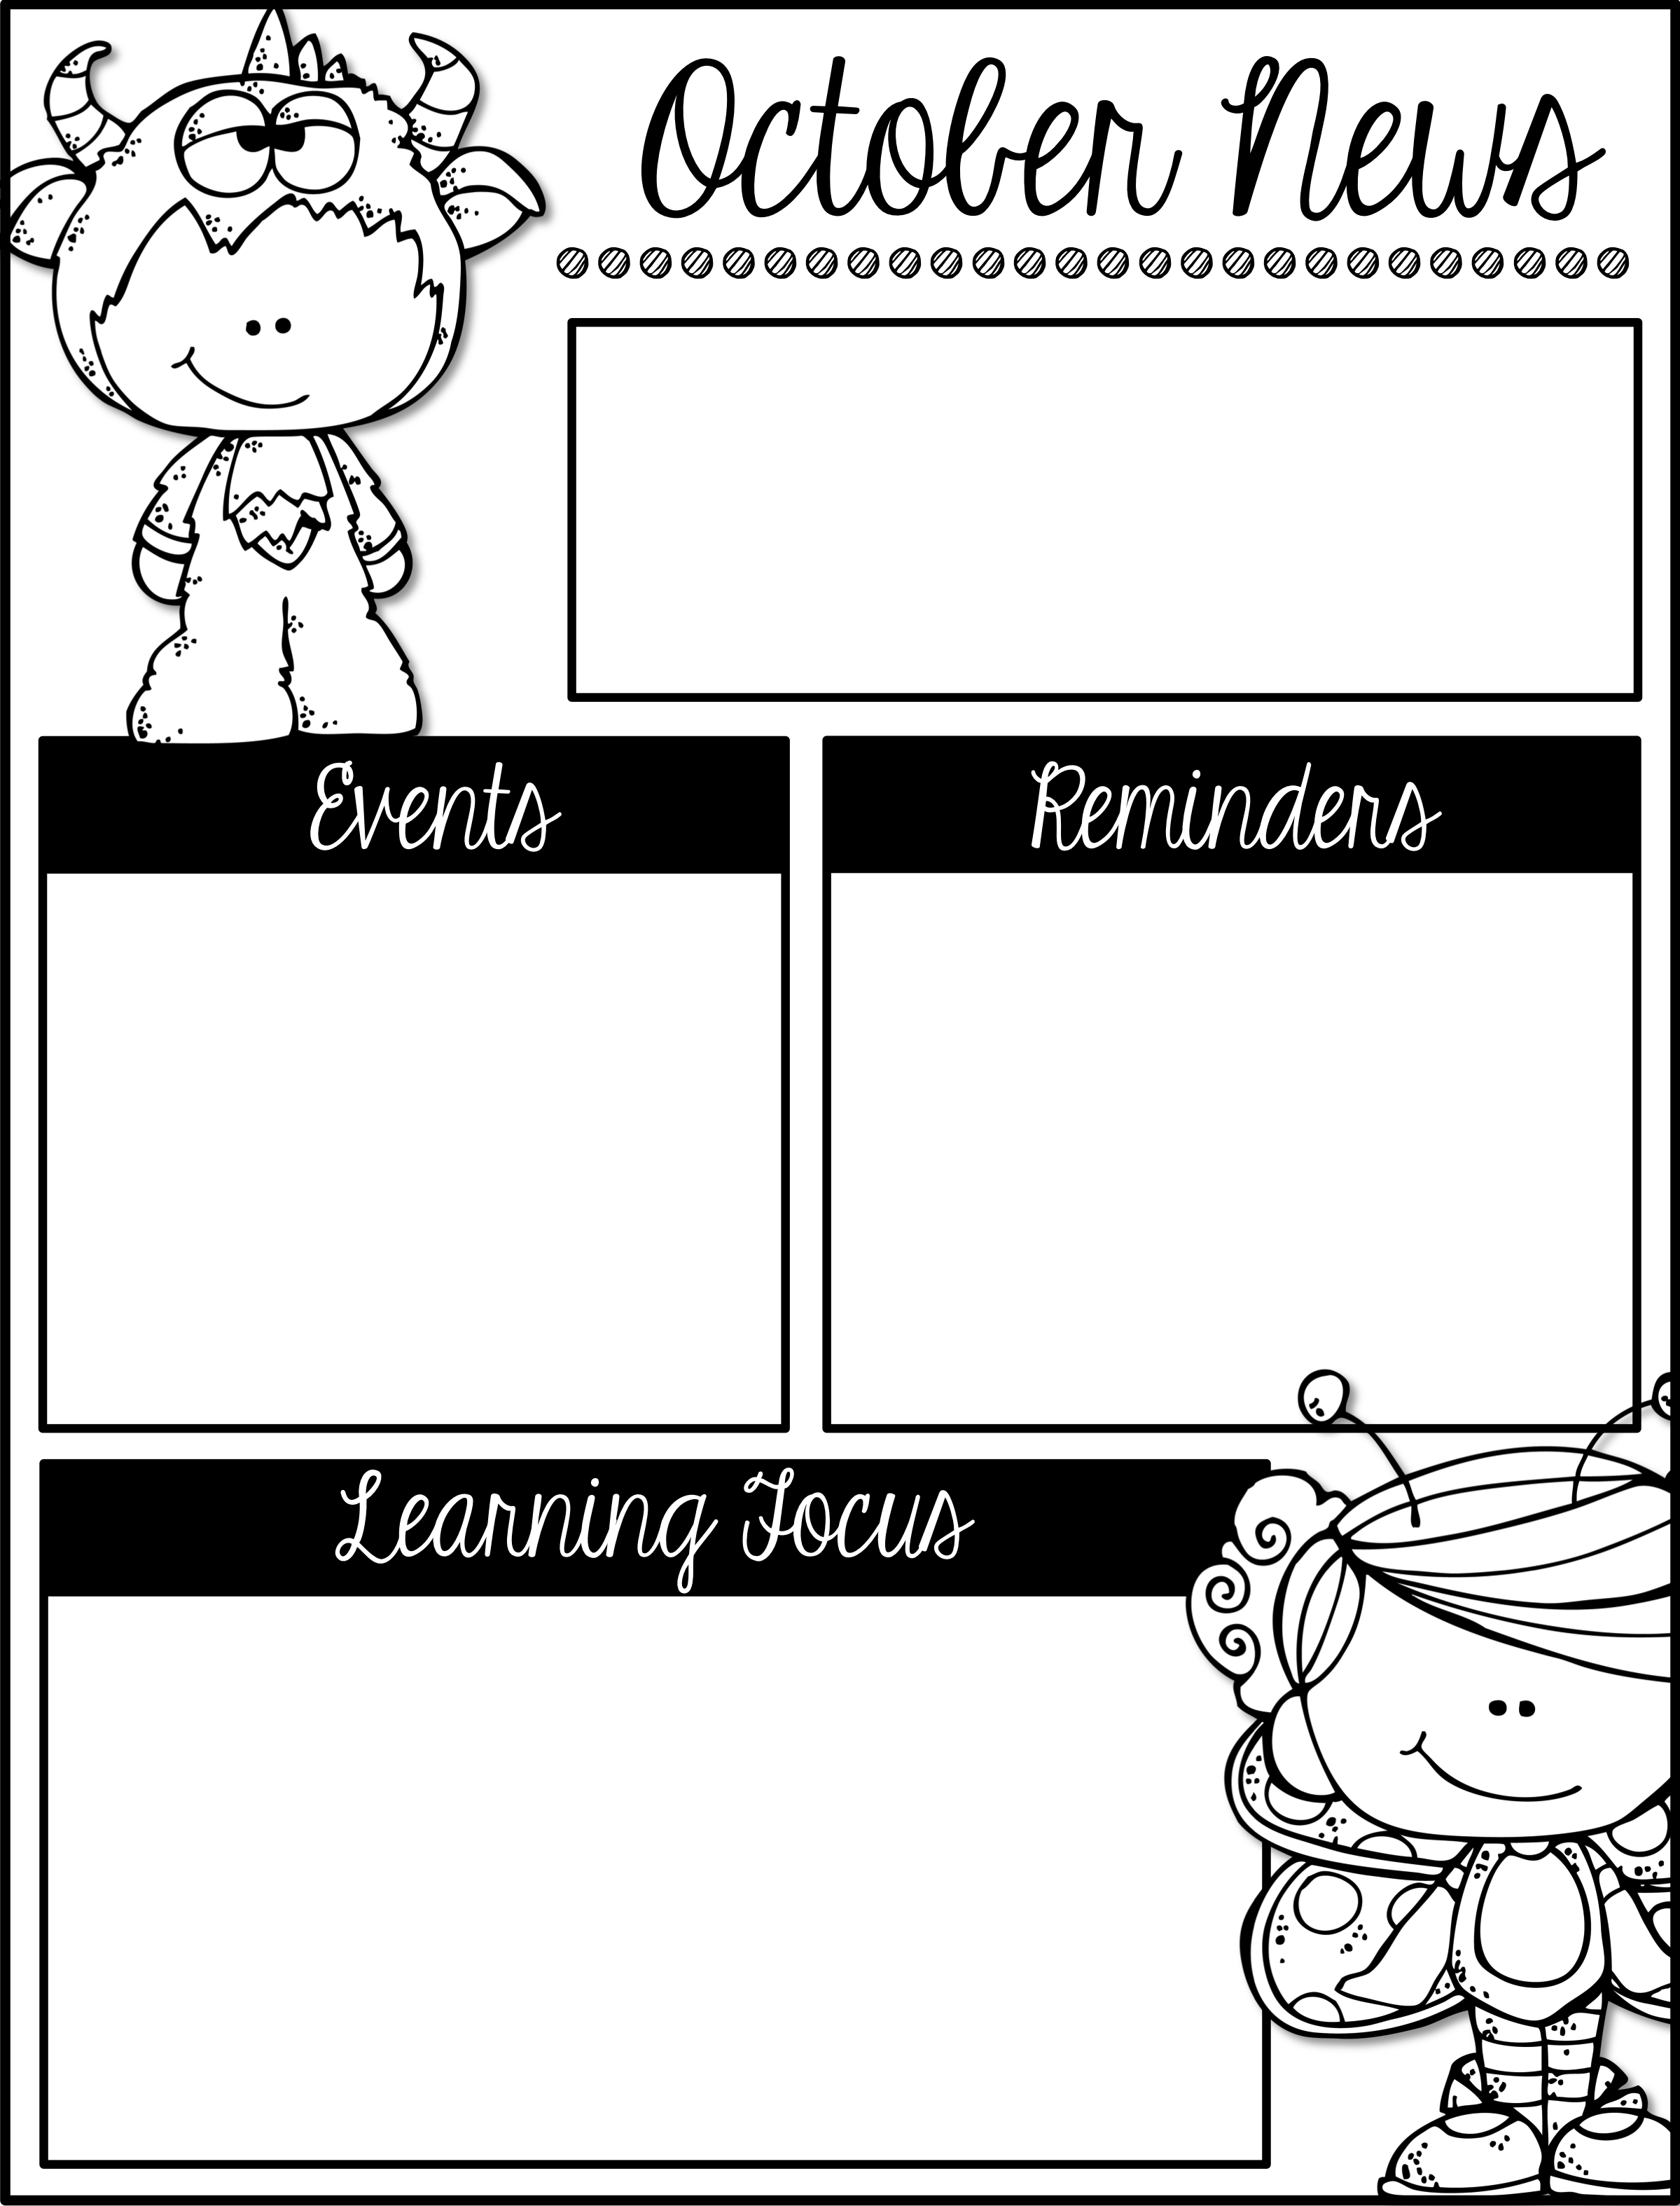
Mrs. Schwabauer’s
First Grade
Week of October 8-12, 2018
*We have been working on an animal research book. We will be writing a page called, “About the Author”. Please send a photo approximately 4 inches by 4 inches. We will be gluing these pictures onto the page, so they will not be able to be reused. Just send in the picture when you can.
*I will be absent on Thursday, Oct. 11 and Monday, Oct. 15 (I will be in Orlando, Florida with my husband and his tennis team playing in USTA Nationals.) I will switch Book Bag books on Tuesday when I return. As always, please alert the office of dismissal changes and absences. Thank you!
October 22, 24, 25: Parent-Teacher Conferences
October 25 & 26: NO school for students
October 31: Harvest Party (more info to come)
November 9: Veteran’s Day Assembly
Here are the goals for the week:
*I can read and write R blend words.
*I can locate facts about an animal’s habitat, food and body using non-fiction books and pebblego.com.
*I can find basic facts using nonfiction features.
*I can record facts I learn while researching.
*I can capitalize the first word and use appropriate punctuation in a sentence.
*I can understand a verb.
*I can recognize the difference between a noun and a verb.
*I can find missing parts of 7, 8, and 9.

