Slide 1
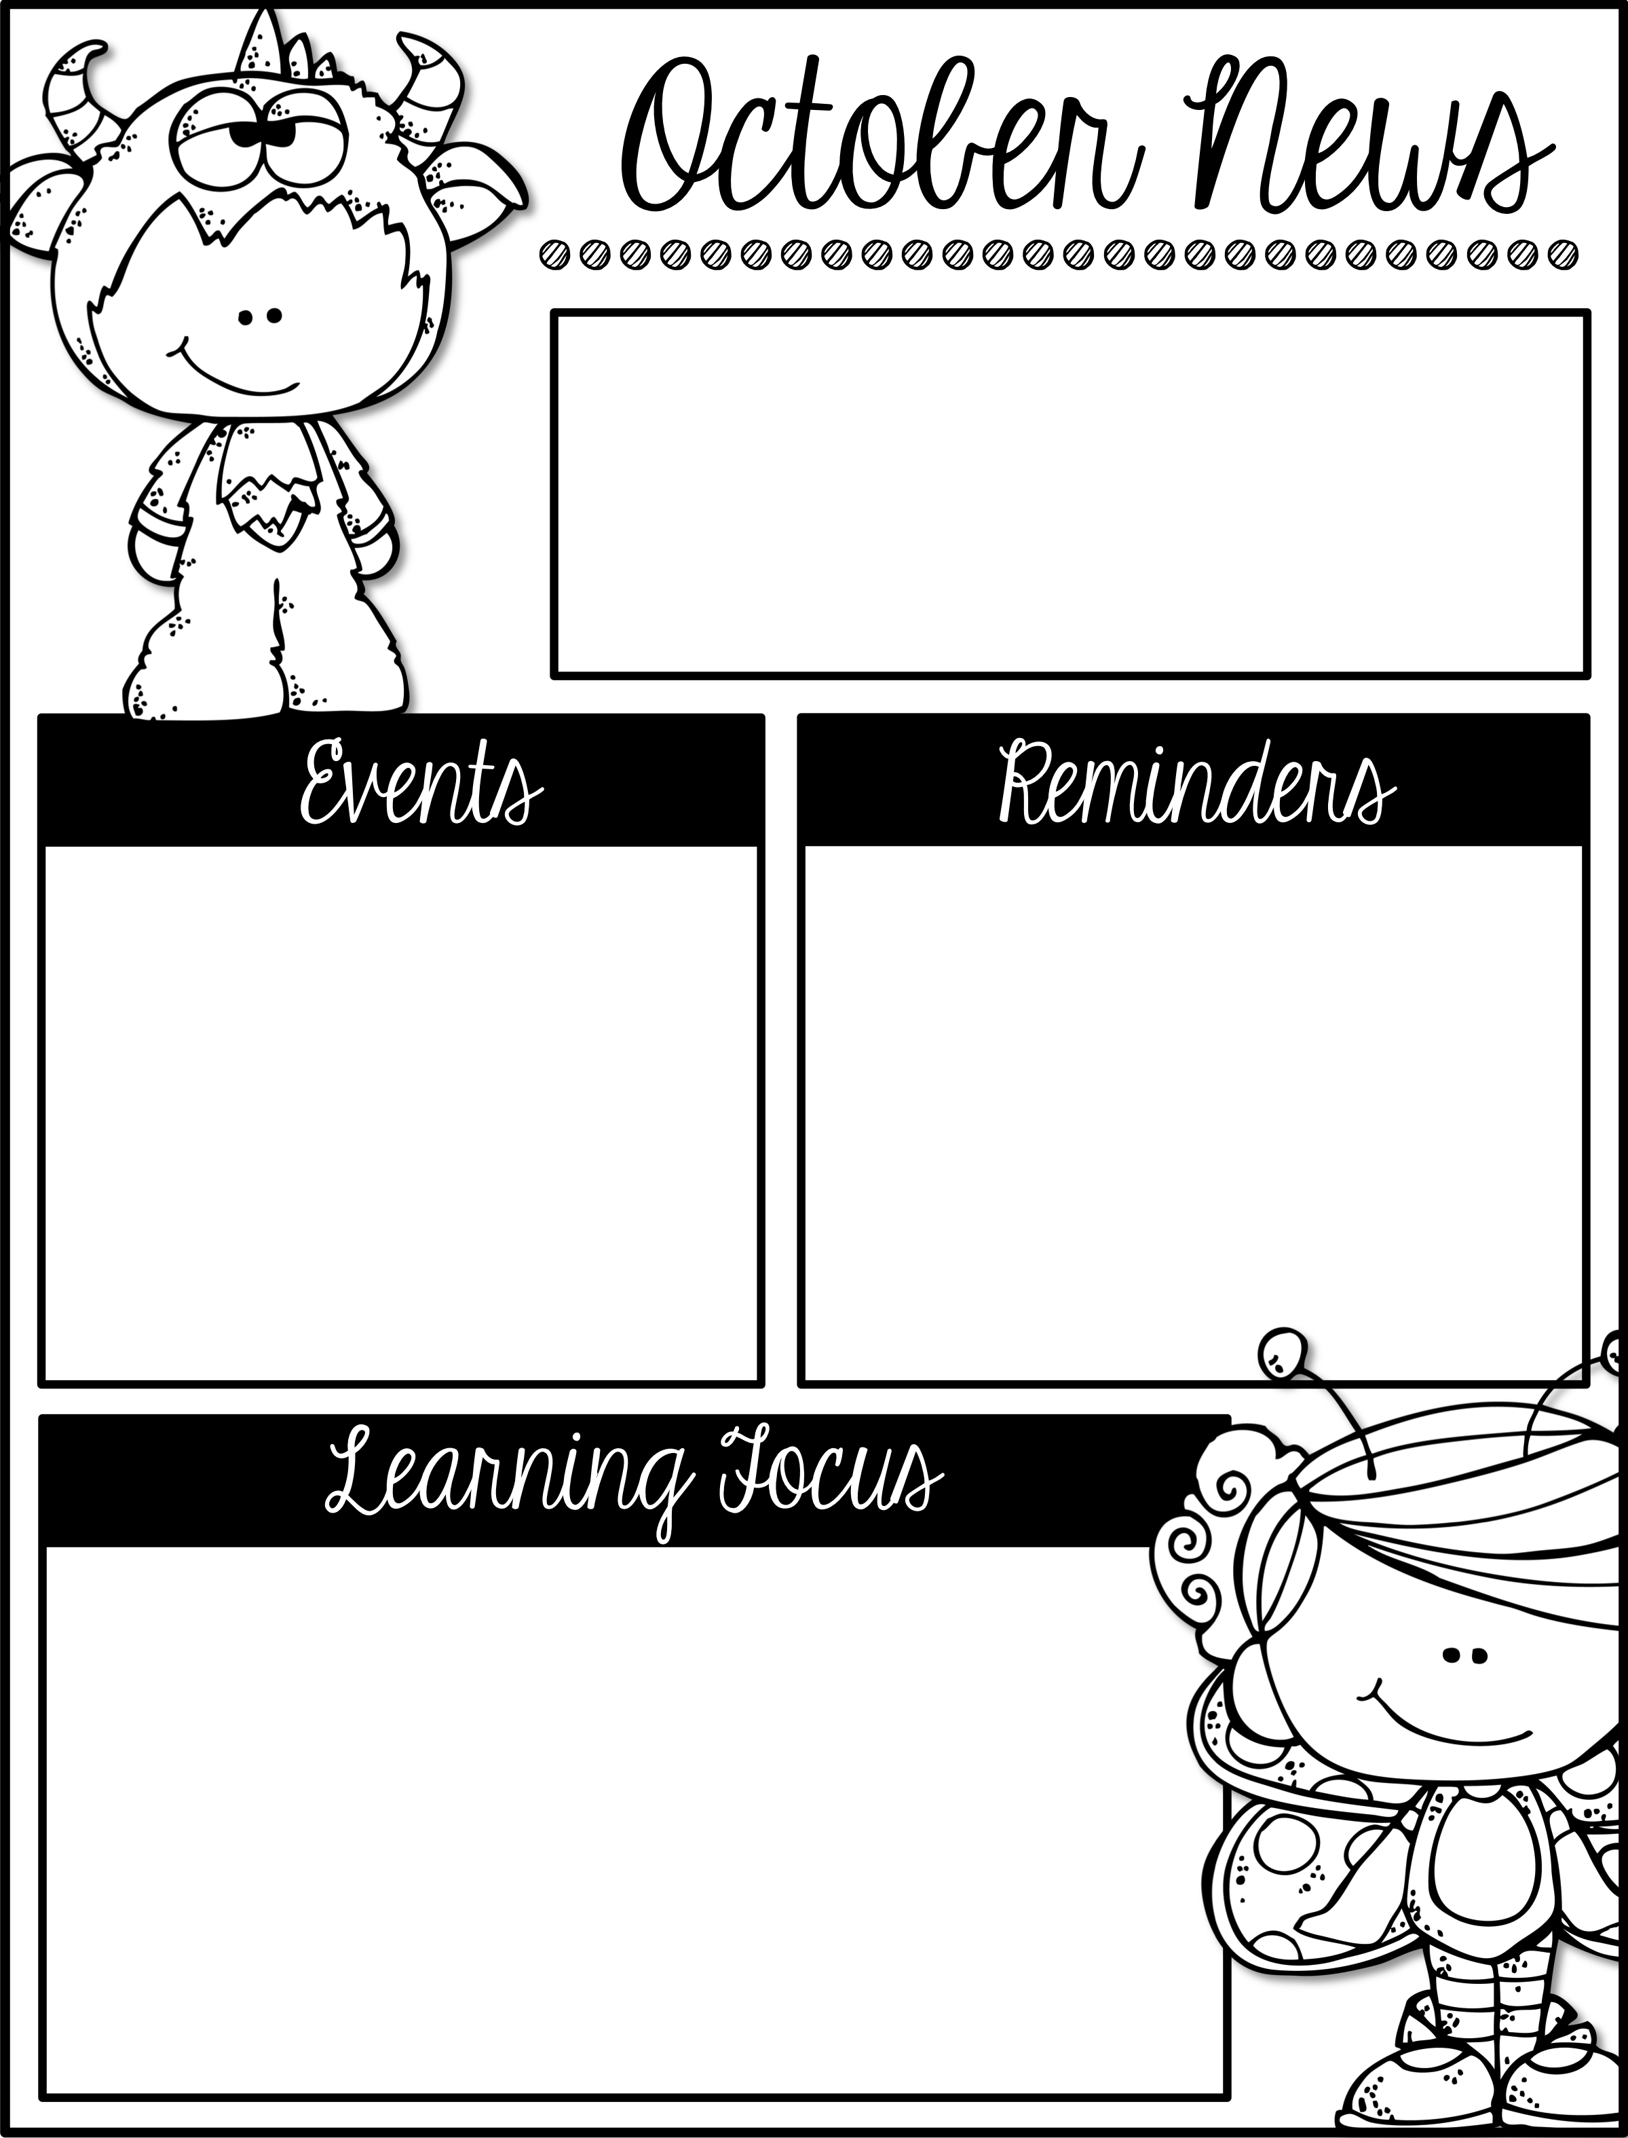
Mrs. Schwabauer’s
First Grade
Week of September 24-28, 2018
*Thank you for all who shopped, ate, played and bought at the OTE Book Fair! It seemed to be a big success. A BIG thank you to all of you who bought books and donated them to our class library. Wow, you were very generous this year!
*I sent home a blue cardstock paper with your student’s usernames and passwords. We have NOT learned about all of the sights. (Your student can experiment in the websites we haven’t learned about, however.)
October 22, 24, 25: Parent-Teacher Conferences
October 25 & 26: NO school for students
October 31: Harvest Party (more info to come)
Here are the goals for the week:
*I can read and write L blend words.
*I can describe features of nonfiction books.
*I can find basic facts using nonfiction features.
*I can capitalize the first word and use appropriate punctuation in a sentence.
*I can distinguish between a common and proper noun.
*I can tell time to the nearest hour and half hour.
*I can identify the five senses found in animals and humans.
*I can describe different animal parts.

