Slide 1
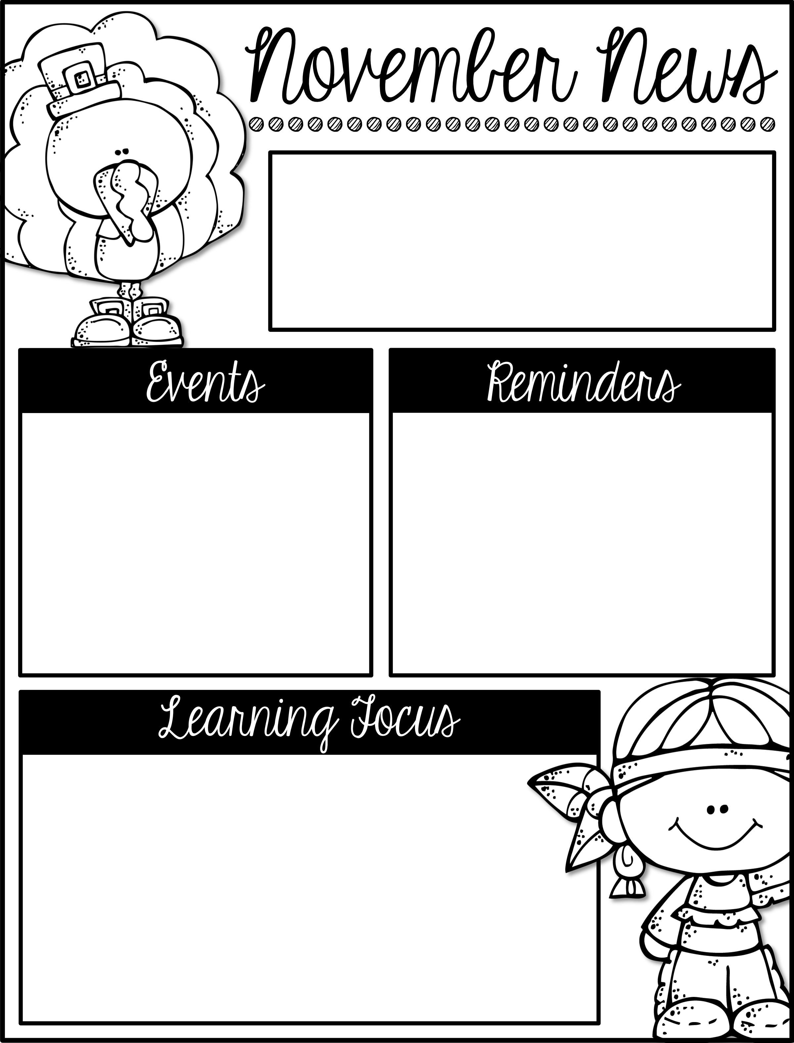
Mrs. Schwabauer’s
First Grade
Week of November 12-16, 2018
*I sent home a Scholastic Book Order with students this week. If you would like to order books for the holidays, let me know. I can keep the books until you can pick them up (without your student knowing). I will place the order the afternoon of November 30.
*We need three packages of the large tortillas and three packages of Oreos for Nov. 20. If you are willing to donate them, please let me know. We will use them for a craft.
November 20: Volunteers Needed
November 21-25: No School (Thanksgiving Break)
December 6: Field Trip to Theater for Young America and Kaleidoscope
(There is no Reading Challenge for November, however we will have one for December.)
Here are the goals for the week:
*I can read and write 3-letter s digraph words (scr, shr ,squ, spl).
*I can add to 12.
*I can use ten-frames to add numbers up to 12.
*I can find facts about a country using the Epic app.
*I can give examples of family traditions.
*I can write about a family tradition.
*I can explain who Native Americans are.
*I can tell about the first Thanksgiving.
*I can give examples of some Native Americans.

