Slide 1
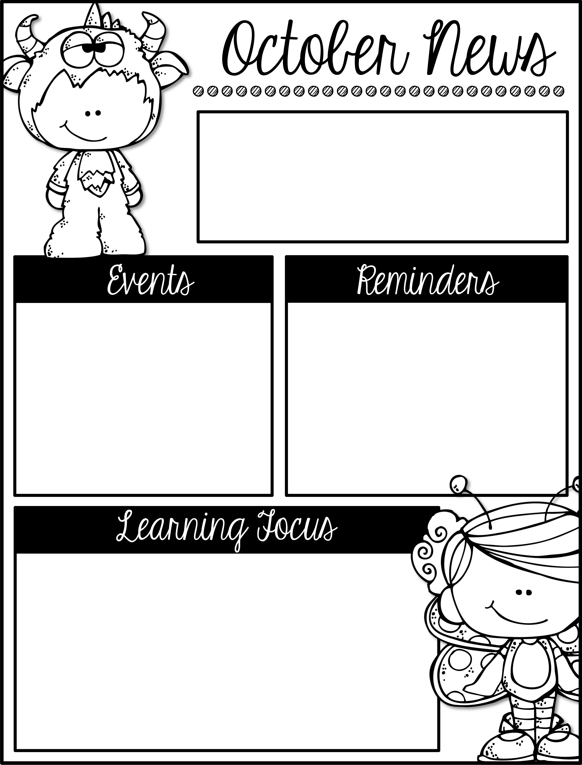
Mrs. Schwabauer’s
First Grade
Week of Oct. 30-Nov. 2, 2018
*We are getting ready to really dig into our next Project Based Learning (PBL) topic next week. A tan paper was sent home about families/heritage this week. Could you please talk with your student about one family story and fill out the pages? I know it will take some time, but I think your first grader will love it. Our goal next week is for students to be able to write about their own family story.
*We do have a November Reading Challenge. Our celebration will involve a big cornucopia of food! Please look for this coming home soon!
**A BIG shout out to our very own room parents who put on a FABULOUS Harvest Party! The kids had fun!!!
November 9: Veteran’s Day Assembly
November 21-25: No School for Thanksgiving Break
Here are the goals for the week:
*I can read and write th, sh, ng digraph words.
*I can explain that a family is a group of people who love/get along with each other.
*I can give examples of how all families are different.
*I can use a ten frame to find sums of two numbers.
*I can recognize a number on a ten frame.
*I can capitalize the first word and use appropriate punctuation in a sentence.
*I can sort nouns and a verbs.
*I can list the continents and/or find them on a world map.

