Slide 1
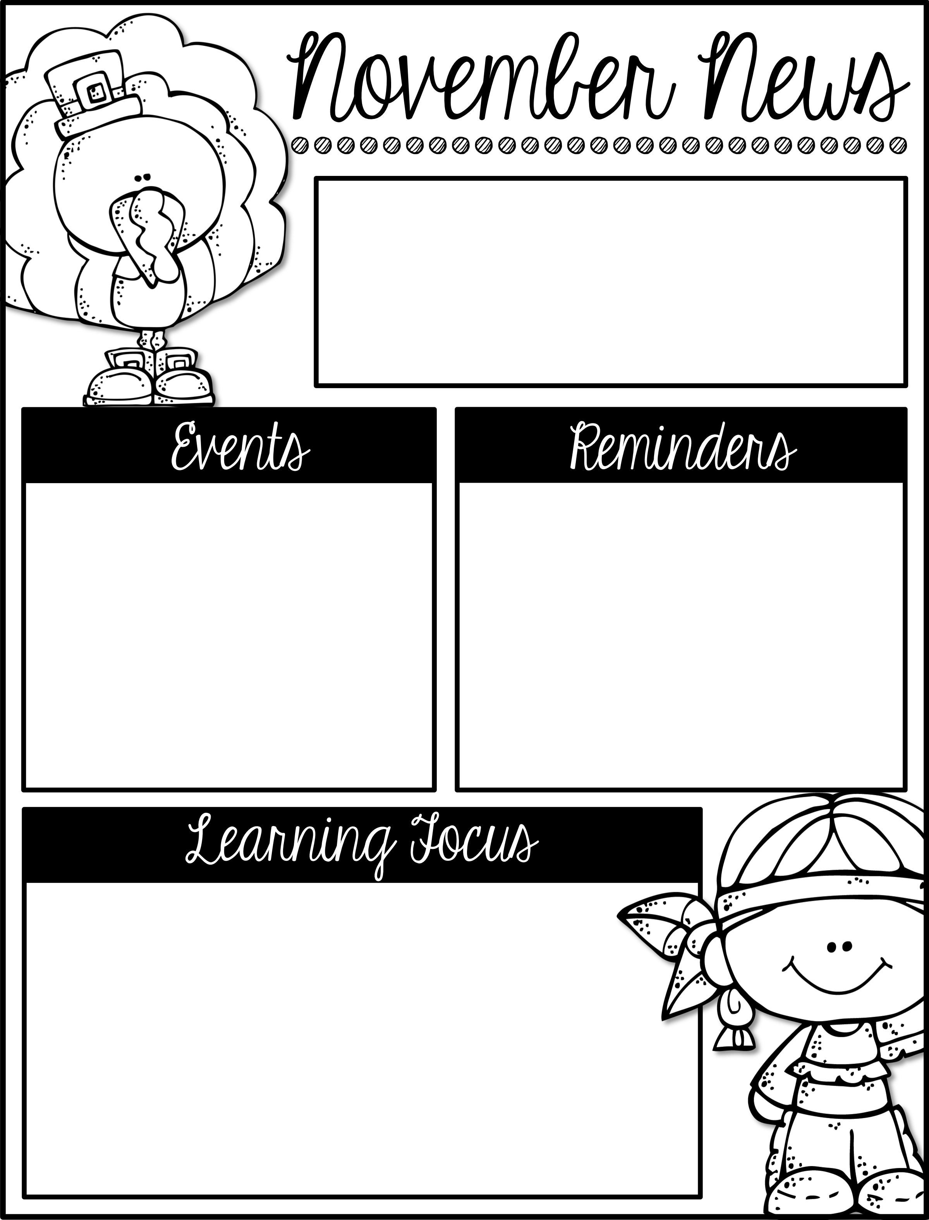
Mrs. Schwabauer’s
First Grade
Week of November 26-30, 2018
December 6: Field Trip to Theater for Young America and Kaleidoscope (please send a lunch for your student)
December 18: December Reading Celebration
December 20: Winter Party with dismissal at 11:45.
December 21-Jan. 6: Winter Break
January 7: School Resumes
*The December Reading Challenge has been sent home. Please have your student read a total of 10 books by December 18. That is the day we will be celebrating with the Polar Express and wearing pajamas all day.
*We are asking students to bring in $2 for their holiday gifts. This year’s gift is pretty awesome and the money we collect is to pay for materials. It would be helpful if you could send the money to school by next Friday, December 7. Thank you!
Here are the goals for the week:
*I can read and write Long o words.
*I can add to 12.
*I can solve word problems by adding or subtracting.
*I can explain that there is more than one way to solve a word problem (draw, use bar diagrams).
*I can learn new facts from a Skype lesson.
*I can give examples of why buffalo were important to the Plains Indians.
*I can write which parts of the buffalo the Plains Indians used and what purpose it had.

