Slide 1
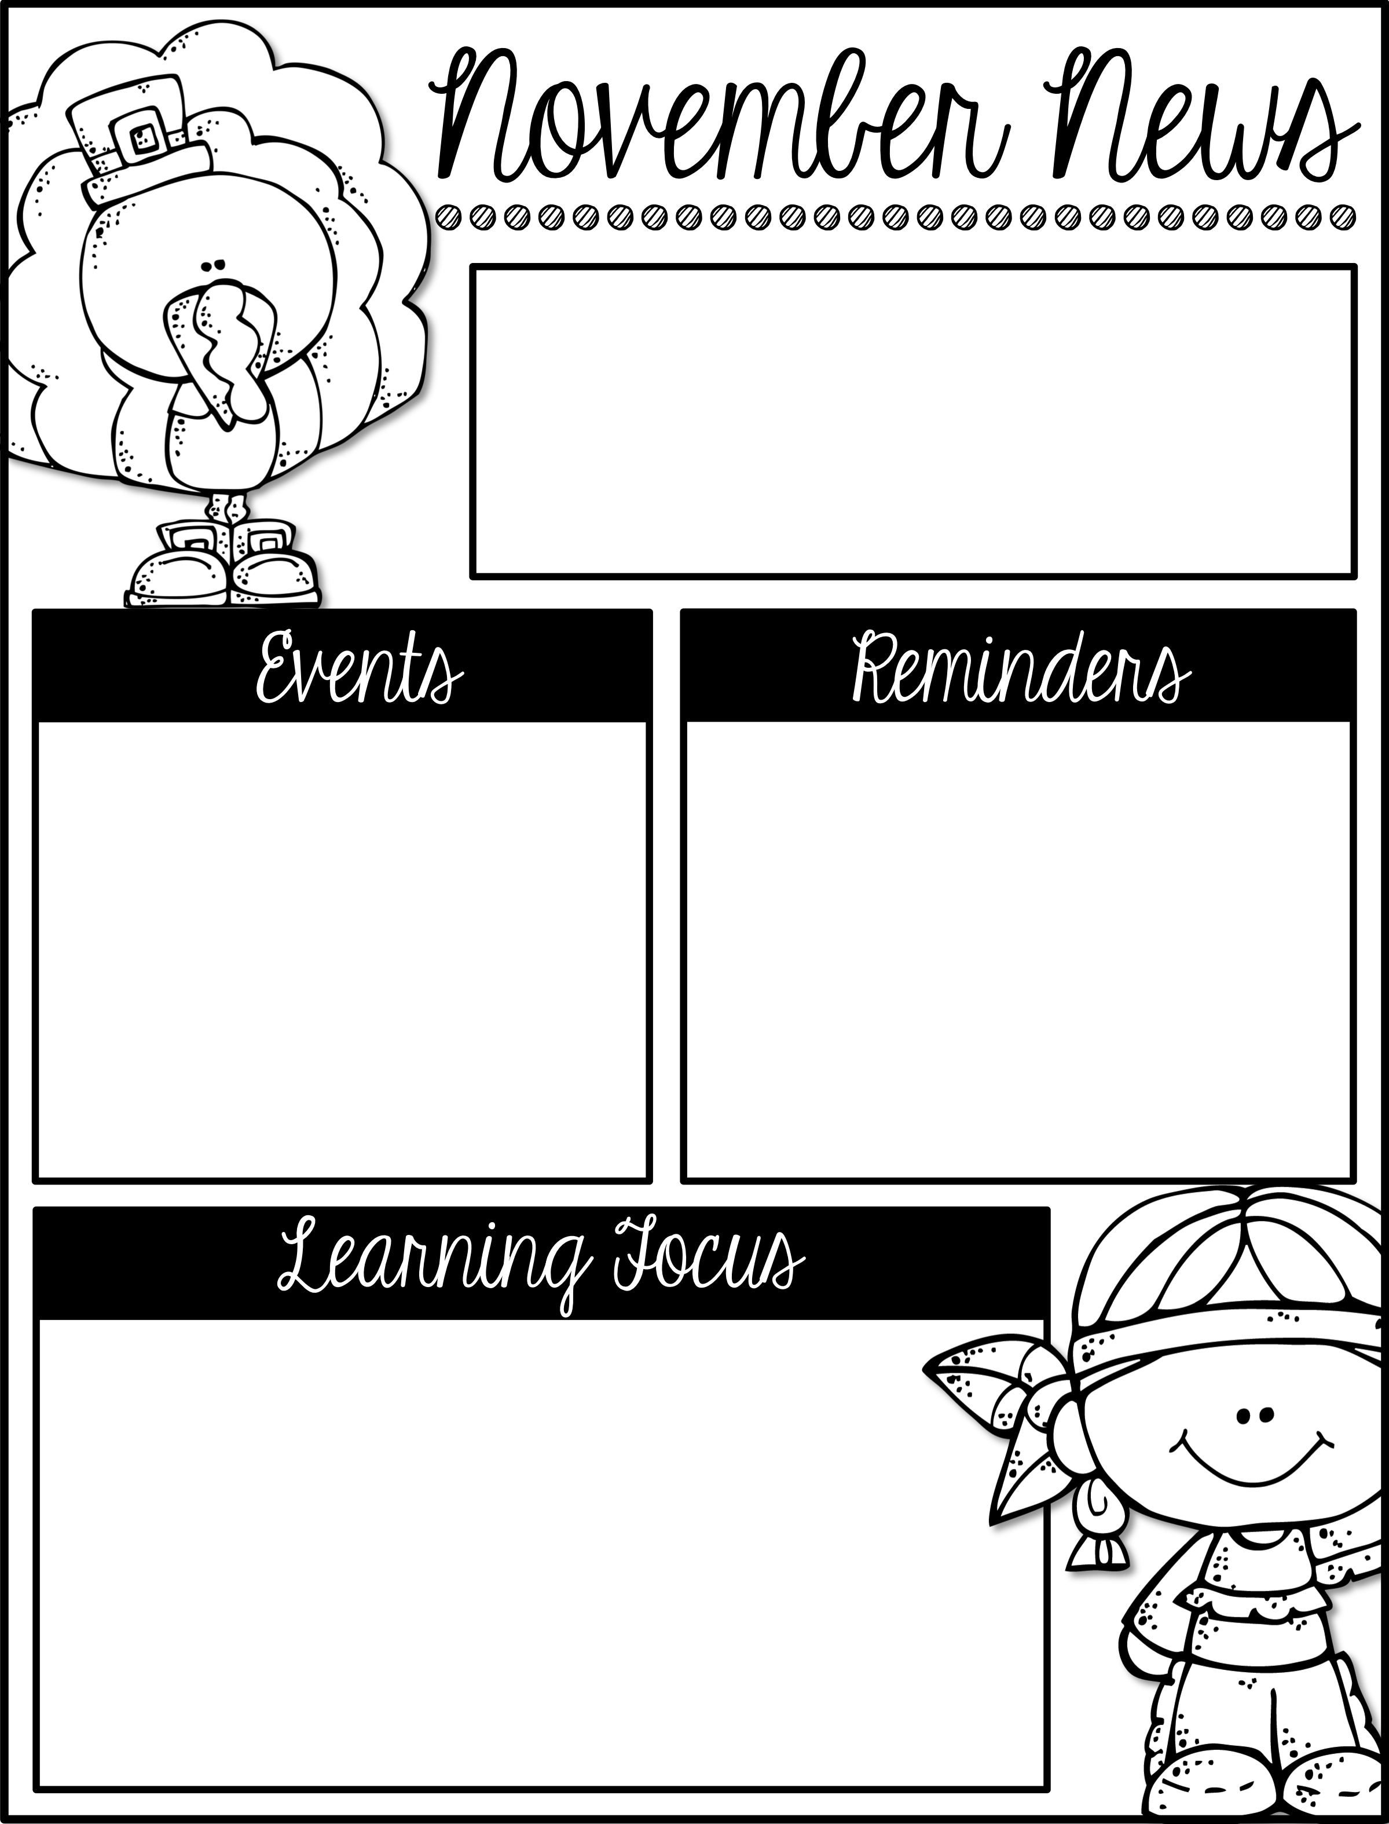
Mrs. Schwabauer’s
First Grade
Week of November 5-9, 2018
*Thank you for filling out the family heritage pages! You guys did an awesome job!! I worked with each student to find the country/countries your family is from. We colored the country on a world map and figured out which continent it was on. It was fun learning about your families!
*We are looking for parent volunteers on Tuesday, November 20 from 9:00-11:00. We need some help with a craft we will be making as part of Thanksgiving. Please let me know if you are interested.
November 20: Volunteers Needed
November 21-25: No School (Thanksgiving Break)
December 6: Field Trip to Theater for Young America and Kaleidoscope
(There is no Reading Challenge for November, however we will have one for December.)
Here are the goals for the week:
*I can read and write ch, tch, wh digraph words.
*I can find missing parts of ten.
*I can make a table to solve a word problem.
*I can tell how I live in more than one place at the same time.
*I can give examples of family traditions.
*I can write about a family tradition.
*I can locate countries on a blank map using a world map online.
*I can use a map to learn where my ancestors are from.
*I can explain why we celebrate Veteran’s Day.

