Slide 1
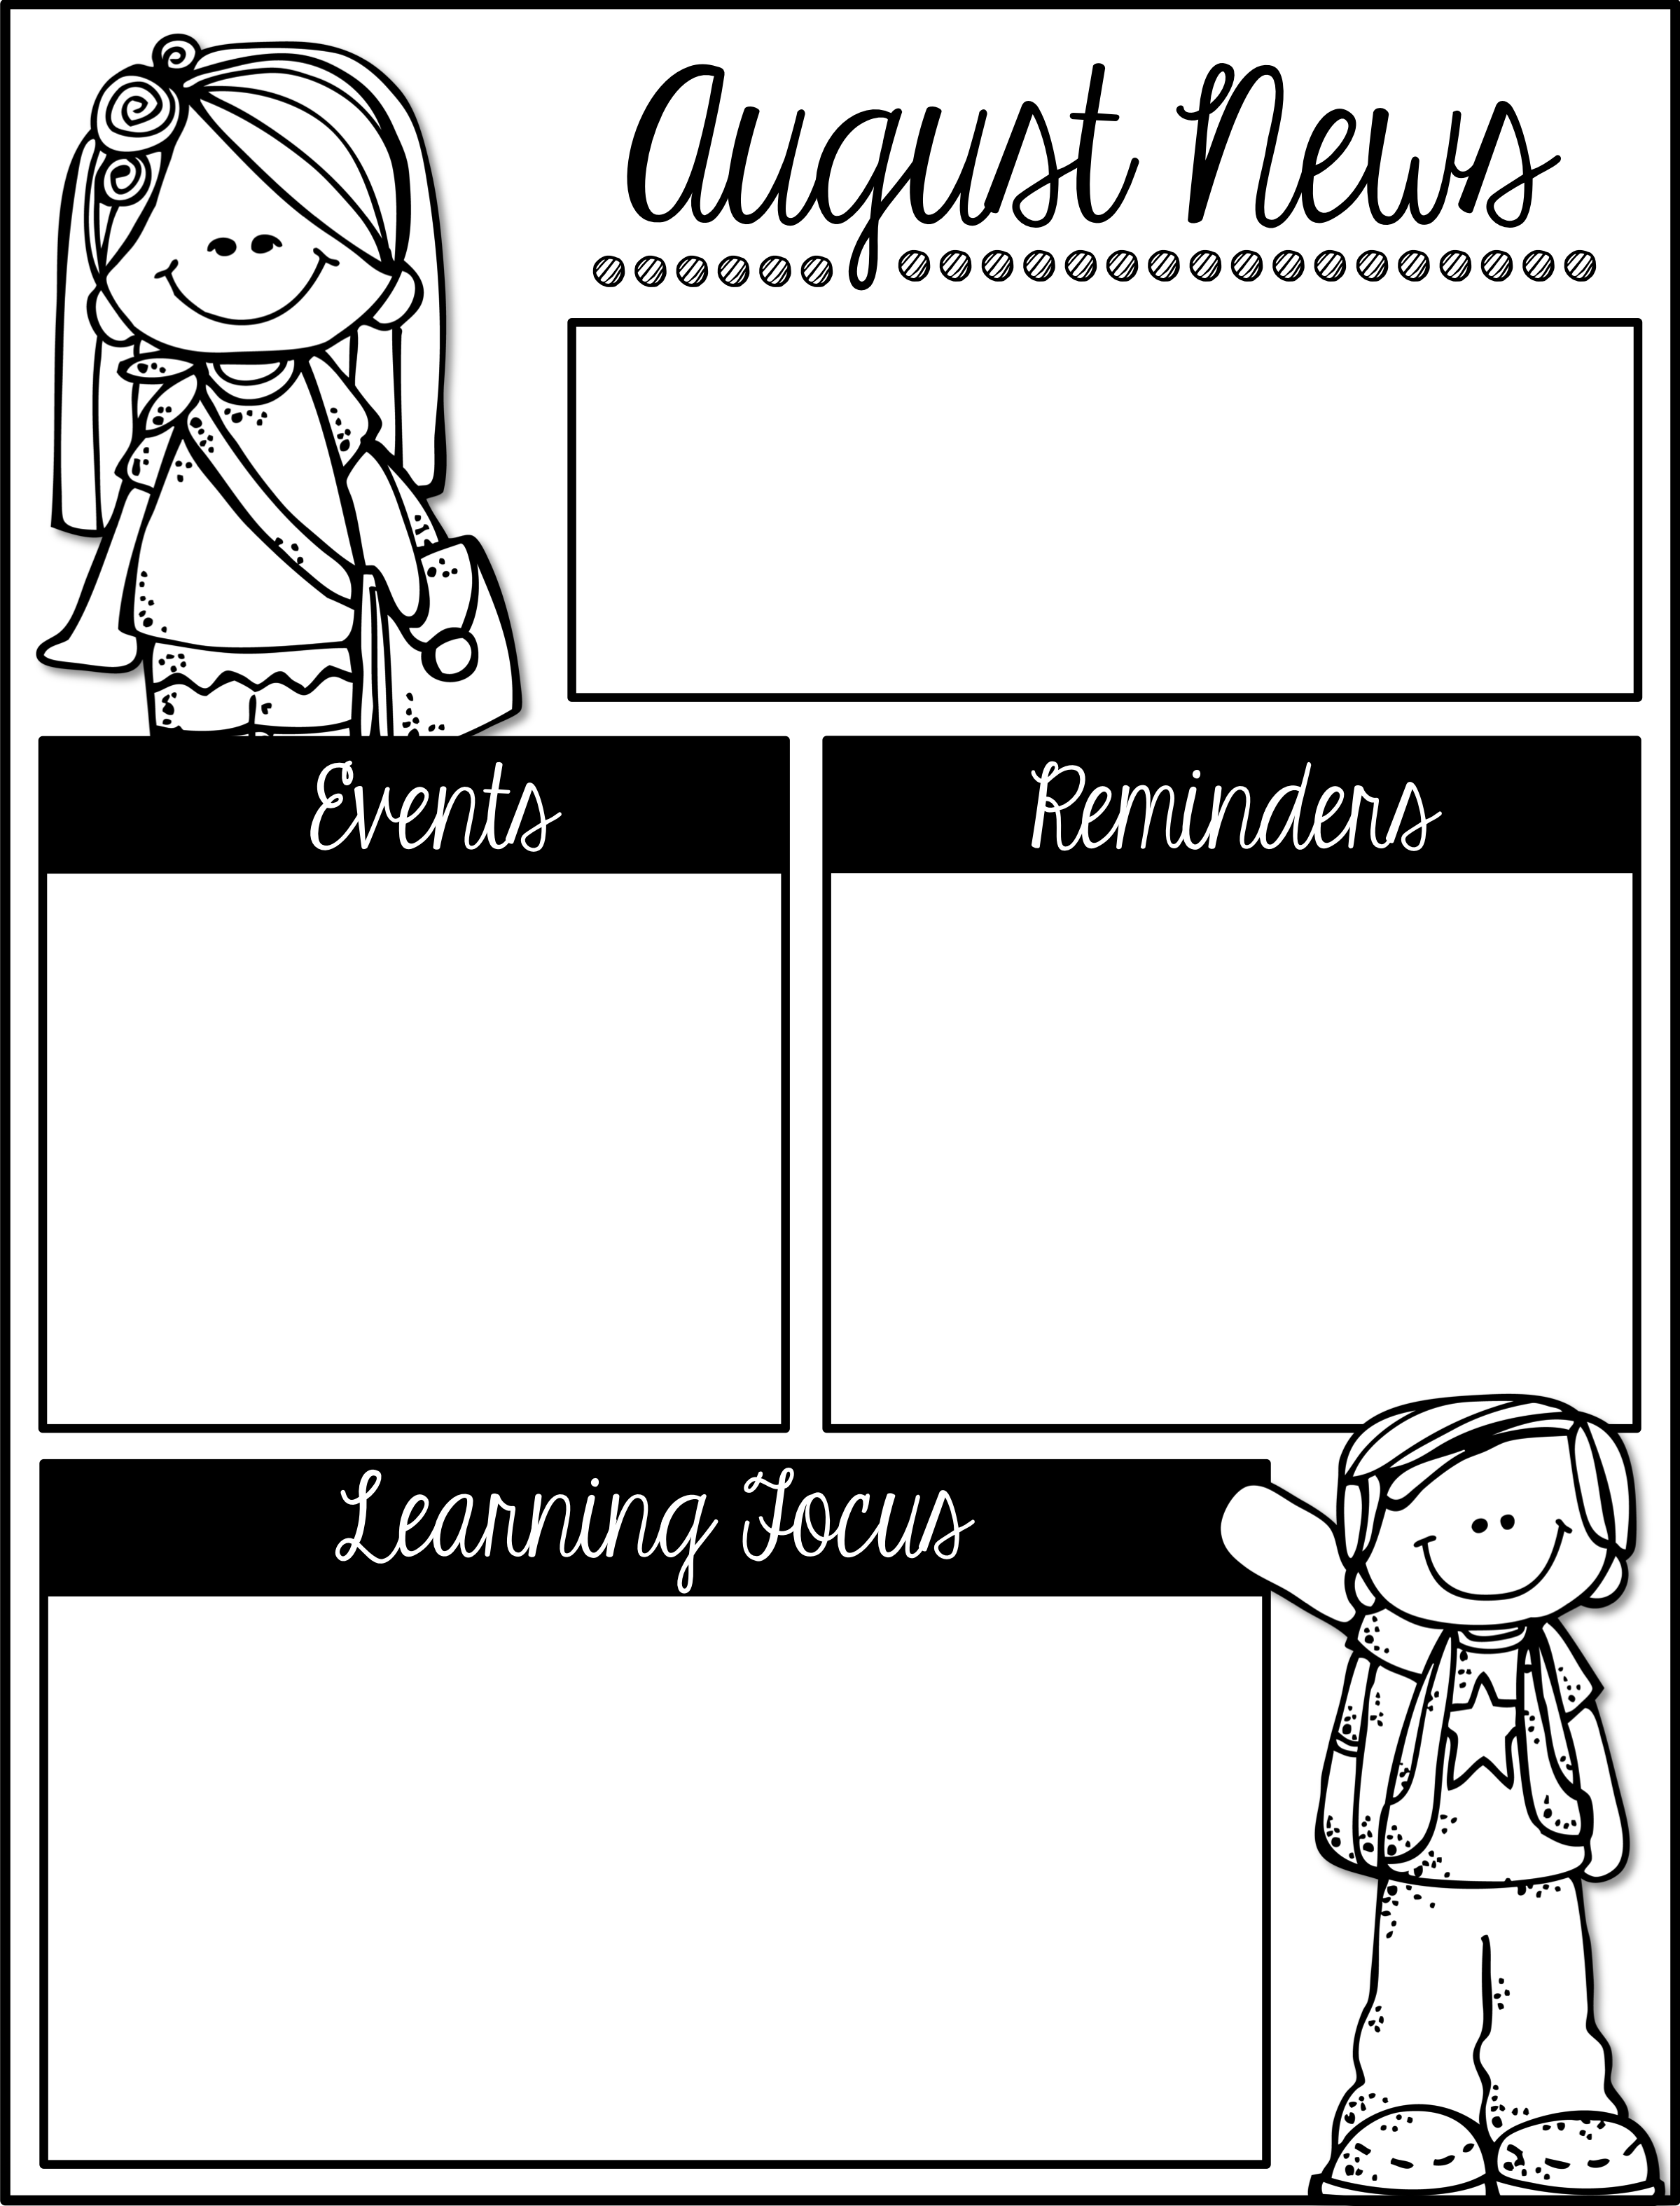
Mrs. Schwabauer’s
First Grade
Week of August 20-24, 2018
*Next Tuesday, August 28th is Back to School Night for parents. I encourage everyone to attend. Ms. Druen will be discussing the school’s new behavior policy and I will be giving lots of helpful information. I look forward to seeing you.
August 28 6:00-8:00: Back to
School Night (parents only)
September 3: No School/Labor Day
September 7: OTE Carnival
September 11: Picture Day
September 14: No School/
Professional Development
We have spent these first few days of school getting to know each other. Lots of our time has been spent learning routines and expectations. Most of our regular schedule is now in place and students are really starting to get a feel for first grade.
Please continue to read for at least 15 minutes each night.

