Slide 1
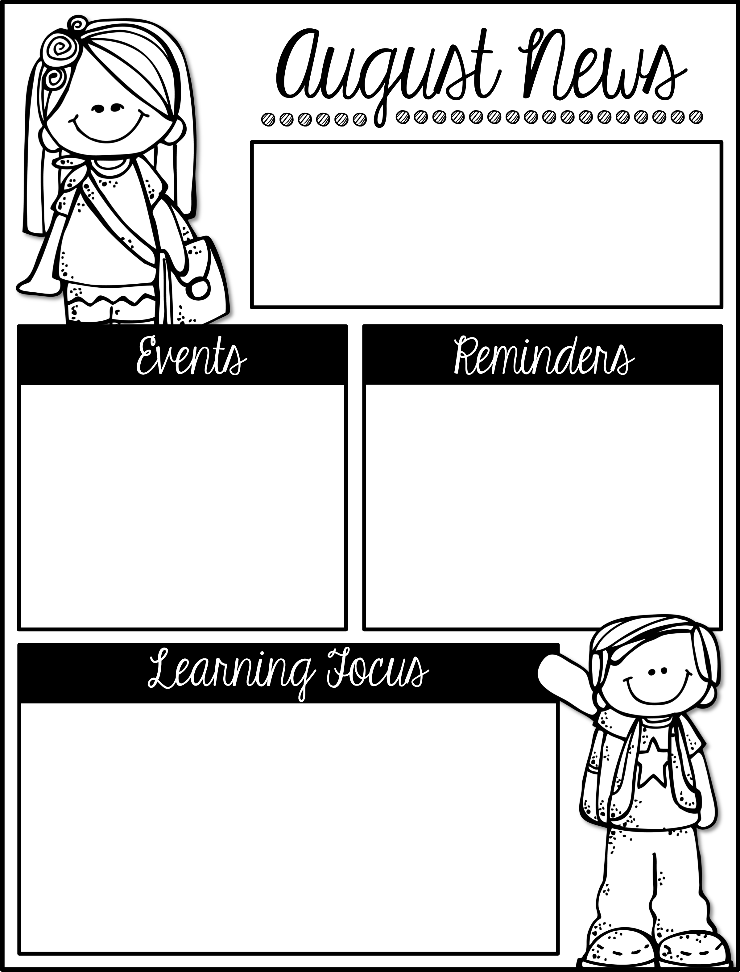
Mrs. Schwabauer’s
First Grade
Week of August 27-31, 2018
*Next week I will be sending home Bag Books. These need to be returned on Mondays (or the first day in the week). I will switch out the books and send them home the same night. I will change book levels as your student’s level changes. I will initially sent home a level that at or below the level your student is currently reading. These are supposed to encourage a love for reading.
September 3: No School/Labor Day
September 7: OTE Carnival
September 11: Picture Day
September 14: No School/
Professional Development
Here are the goals for the week:
*I can read and write short a words.
*I can capitalize the first word in a sentence.
*I can read-to-self (alone for a short sustained time.)
*I can understand I am part of several different communities.
*I can create pictures using shapes.
*I can make shapes from other shapes.
*I can work in a group cooperatively.
*I can work independently.

