Slide 1
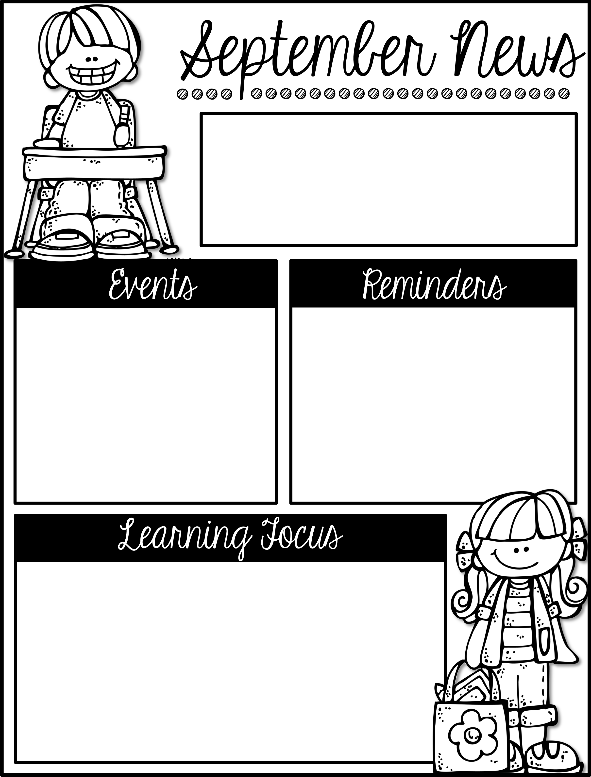
Mrs. Schwabauer’s
First Grade
Week of September 10-13, 2018
*Bag Books: These are switched out on Monday (or the first day in the week we are at school). I apologize I forgot on Monday! ☺ Please just write in the name of the book one time on the sheet. That means you will add two titles each week.
*Reading Challenge: We will have a monthly reading challenge almost every month this year. The deadline is the last day in the month. You can write books from the Book Bags on the list. Library books are also great for this list.
October 22, 23, 25: Parent/Teacher Conferences
If you have not signed up for a time, here is the link: https://www.signupgenius.com/go/30E0D48ACA728A1FE3-fall
I look forward to meeting with you in October.
Here are the goals for the week:
*I can read and write short 3 words.
*I can capitalize the first word in a sentence.
*I can distinguish between a common and proper noun.
*I can name solid figures.
*I can give characteristics of solid figures (surfaces, vertices).
*I can name community helpers.
*I understand that citizens have responsibilities and privileges can be granted or taken away.
*I can work independently.
*I can identify patterns on dice.
*I can add two numbers to make 6 and 7.

