Slide 1
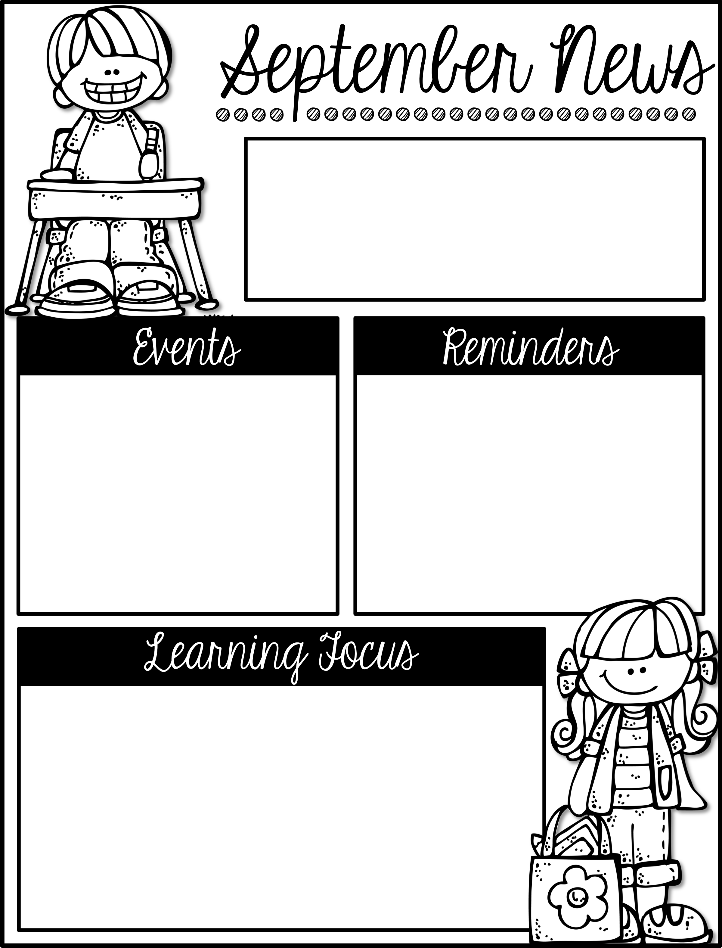
Mrs. Schwabauer’s
First Grade
Week of September 17-21, 2018
*Book Order: I sent a Scholastic Book Order home with students on Tuesday. The orders are due by next Friday, September 28. If you lost your order, you can go online to https://clubs.scholastic.com/ . The class code is RD2GY. Thanks for ordering!
*Reading Challenge: The footballs are due next Friday, September 28. On that day we will be having our tailgate. Please send a blanket or towel for your student to sit on. It would be helpful if your student brought a lunch that day.
We have had a great week in first grade. Thank you for sharing your sweethearts with me!
October 22, 23, 25: Parent/Teacher Conferences
If you have not signed up for a time, here is the link: https://www.signupgenius.com/go/30E0D48ACA728A1FE3-fall
I look forward to meeting with you in October.
Here are the goals for the week:
*I can read and write short e words.
*I can make text-to-self connections.
*I can make text-to-text connections.
*I can make test-to-world connections.
*I can capitalize the first word in a sentence.
*I can distinguish between a common and proper noun.
*I can make sums to 9.
*I can read a story problem and find the parts and the whole.
*I can tell about the Constitution.
*I can explain who can be the President of the United States.
*I can describe how people vote.
*I can work independently to complete work.

