Slide 1
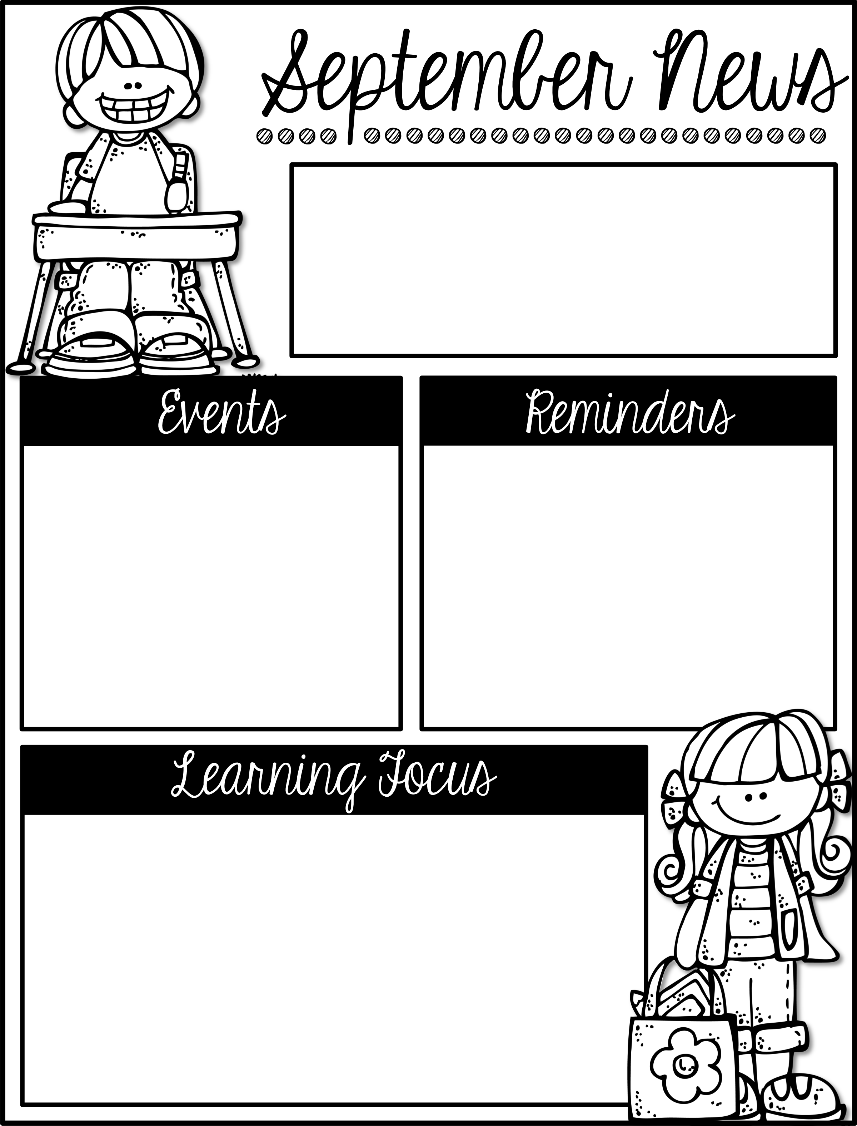
Mrs. Schwabauer’s
First Grade
Week of September 24-28, 2018
*There is a new Reading Challenge for October. It will be sent home on Monday. Thank you for reading with your student and helping to foster a love for reading.
*The OTE Book Fair is next week. We will visit on Tuesday at 1:00. You can send money with y our student to purchase books. This is a great way to replenish your home library and help the school at the same time! Thanks for your support.
Tuesday, Oct. 2: Family Night at the Book Fair (6:00-8:00 pm)
Thursday, Oct. 4: Donuts with Mom and Dad at the Book Fair (7:30-8:30 am)
October 22, 23, 25: Parent/Teacher Conferences
If you have not signed up for a time, here is the link: https://www.signupgenius.com/go/30E0D48ACA728A1FE3-fall
I look forward to meeting with you in October.
Here are the goals for the week:
*I can read and write short u words.
*I can describe traits of a character in a fiction story.
*I can recognize fiction from nonfiction books.
*I can find connections between stories.
*I can capitalize the first word in a sentence.
*I can distinguish between a common and proper noun.
*I can explain that there are different ways to order parts, and that order doesn’t effect the sum.
*I can identify animals who are alike and different.
*I can tell how animals are like their parents and others of their same kind.

