Slide 1
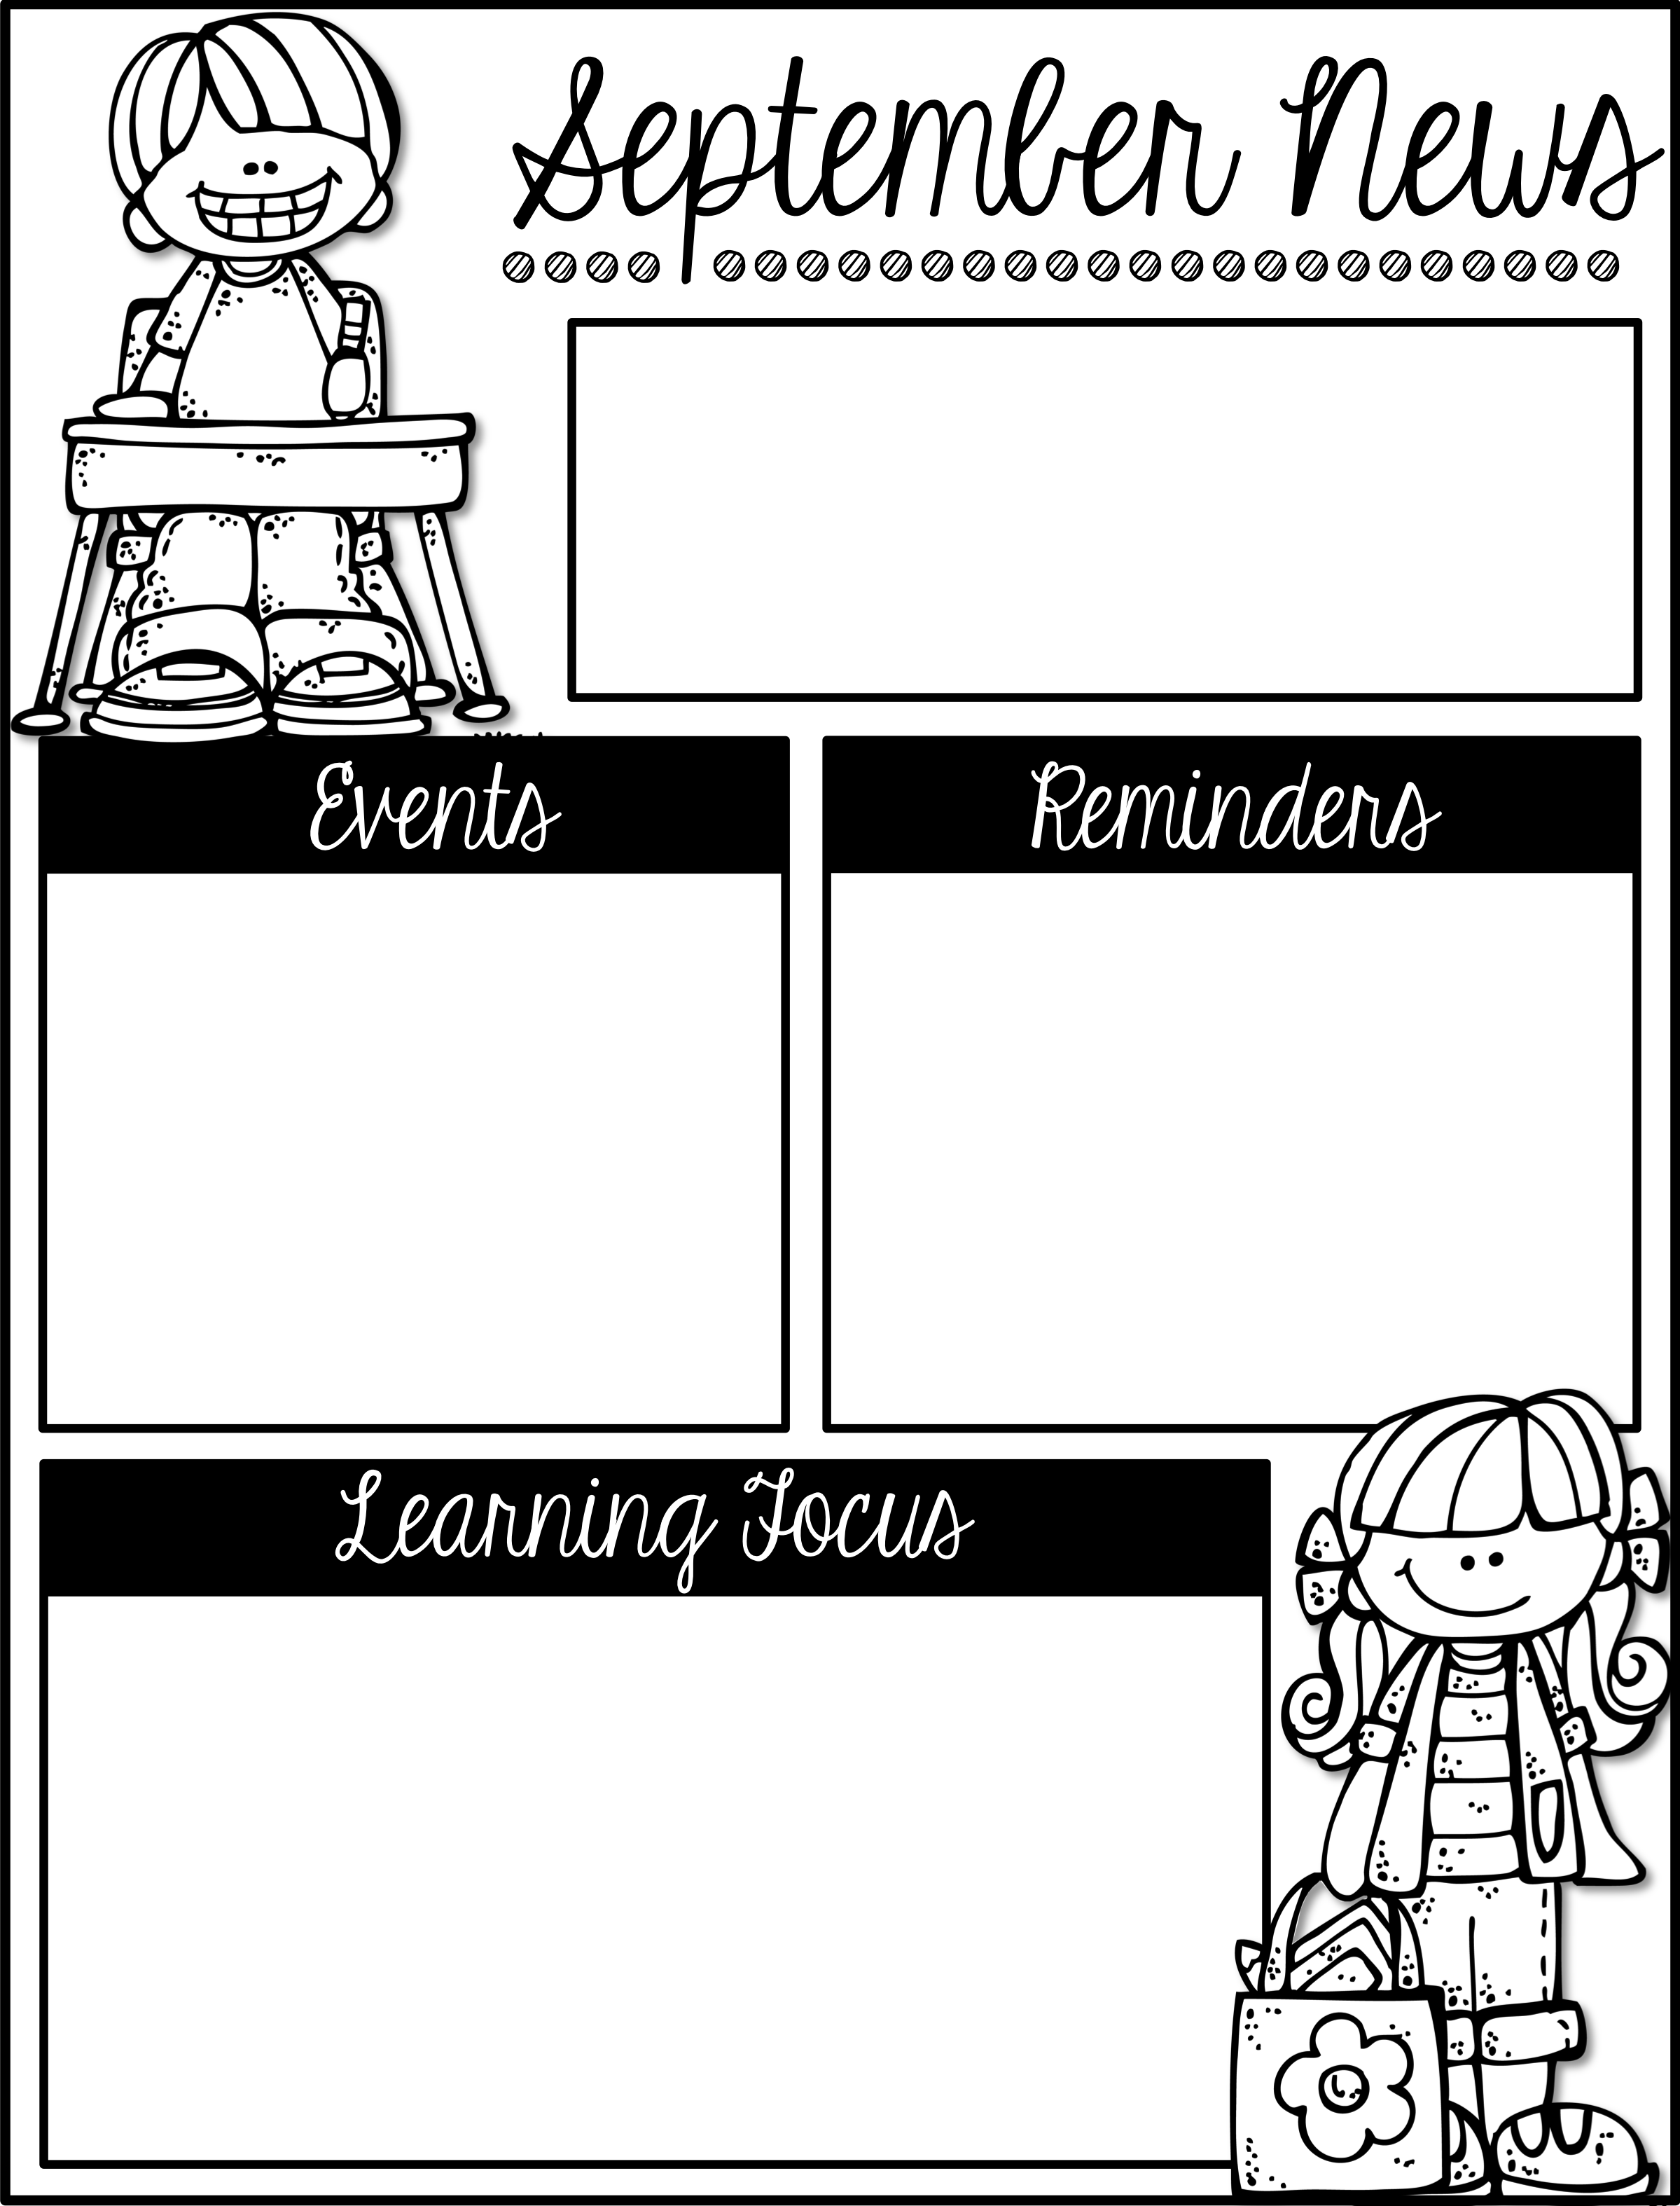
Mrs. Schwabauer’s
First Grade
Week of September 4-7, 2018
*Bag Books were sent home on Tuesday. These are for students to read and return the following Monday (or the first day in the week). These are not supposed to be too challenging, they are more about practice. The paper inside the bag explains how to fill out the chart. Thank you for reading with your student.
*We had an all-school assembly on Friday to kick off our school-wide discipline plan. We will do lots of things to learn about making good choices. Please ask your student about Pride Paws, as I am sure they will be excited to tell you about them.
September 7: OTE Carnival
September 11: Picture Day
September 14: No School/
Professional Development
Here are the goals for the week:
*I can read and write short i words.
*I can capitalize the first word in a sentence.
*I can distinguish between a common and proper noun.
*I can name different types of homes and community settings.
*I can name solid figures.
*I can give characteristics of solid figures (surfaces, vertices).
*I can tell what a responsible citizen does in a community.
*I can work independently.

